Slide 1
Ministry / Organisation Name : Ministry of AYUSH Problem Statement : AUDIO Guide for patient regarding doctor prescription. Team Name : Team Electrica Team Leader Name : Utkarsh Nimje Problem Statement ID : SH6 College Code : 1-3516268944

Slide 2
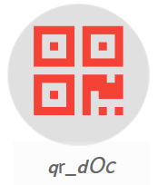
OBJECTIVE
- Routinely patients are advised orally; health cares like diet, lifestyle and medication dosage and frequency in the patient doctor visit, which is very difficult for a patient to remember after he goes home. The objective is to convert doctor’s advice (Audio) to QR code and QR code to be pasted on the patients prescription. A patient can scan the QR code and listen the health advisory by the doctor through mobile app.

Slide 3


OUR IDEA
The smartphone application to be created such that both the doctor as well as patient will each get an account based on their position ( i.e. a doctor specific account and a patient specific account).
The doctor can give voice input (voice data will get stored on the dedicated servers of the app) for the medication data or he can simply enter it in the database provided in the app.
Entered prescription data values will get encoded into a QR code which then can be printed on the prescription sheet or can be transferred digitally.
As soon as this QR code is scanned on the patient’s account of the app the database such as medication time, dosage, frequency etc will automatically get filled.
If the doctor chooses to upload his speech/audio, he can simply connect his smartphone to internet and do so from the app. The patient on the other hand will have to download this audio clip from our server which can be done from the app itself.

Slide 4
PROTOTYPE

Slide 5
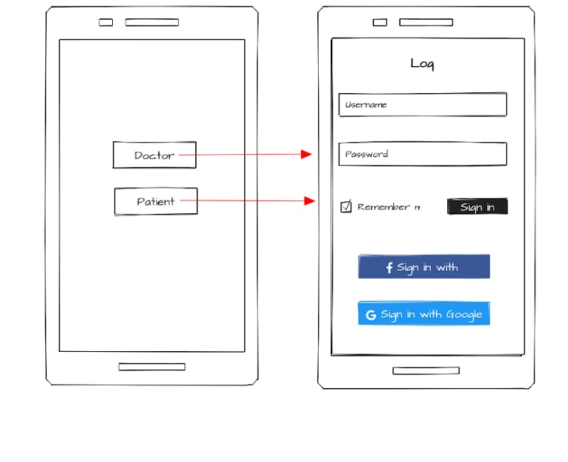
Meet qr_dOc

Slide 6
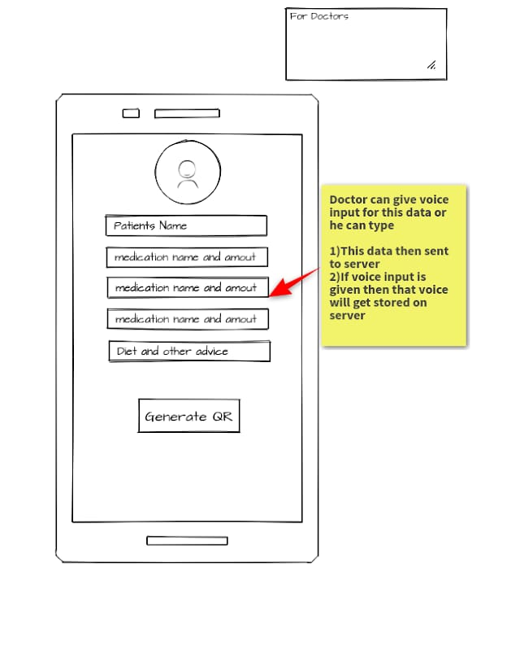
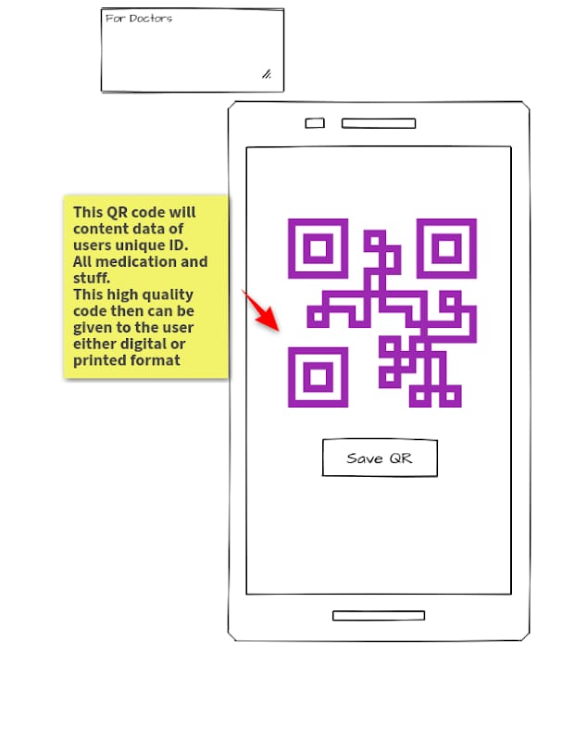

Slide 7
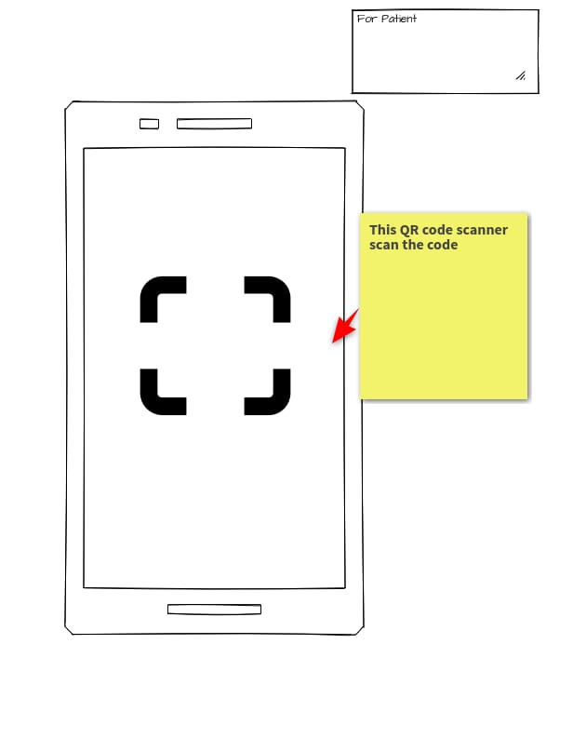
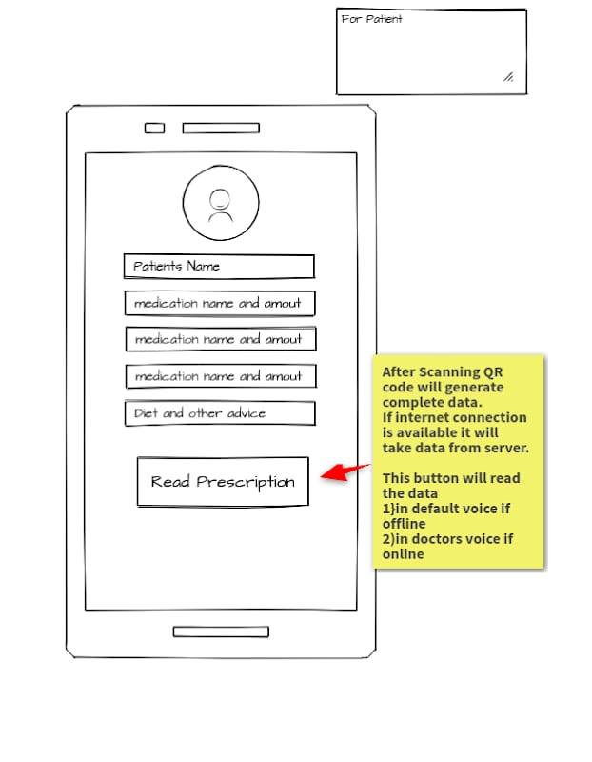

Slide 8
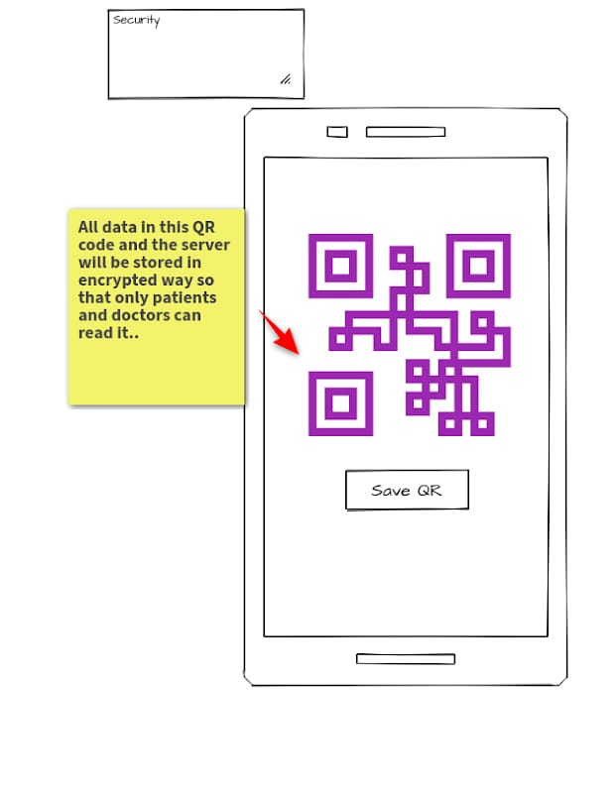
Privacy of our clients will be totally accounted for and so all the data exchange will occur with an end-to-end encryption.

